Slide 1
The Power of Difference in Fundraising
Pennylope Kapere
Associate Director for Equity and Justice at London Funders

Slide 2
Why does difference matter?
Defining difference in fundraising
The positive impact of difference
The collective responsibility
What are you going to do differently today?

Slide 3
#InclusionStartsWithI

Slide 4
Defining difference in fundraising
Diversity is where everyone is invited to the party
Inclusion means that everyone gets to contribute to the playlist
Equity means that everyone has the opportunity to dance/experience the music

Slide 5
The positive impact of difference
“Diversity is the spice of life”
Secondly to have a successful fundraising campaign you need diverse perspectives and those are usually generated from people who come from a different walk of life and have different lived experience.

Slide 6
The positive impact of difference
Diversity boosts productivity, drives innovation and most importantly brings more money to your organisation
The beneficiary groups you are hoping to help, need to see a diverse team and workforce to feel represented within the mission and values of your organisation. You cannot have a mission statement that indicates that you are keen to help everyone yet the people making decisions are not reflective of the diverse communities we all live in – It doesn’t make sense.

Slide 7
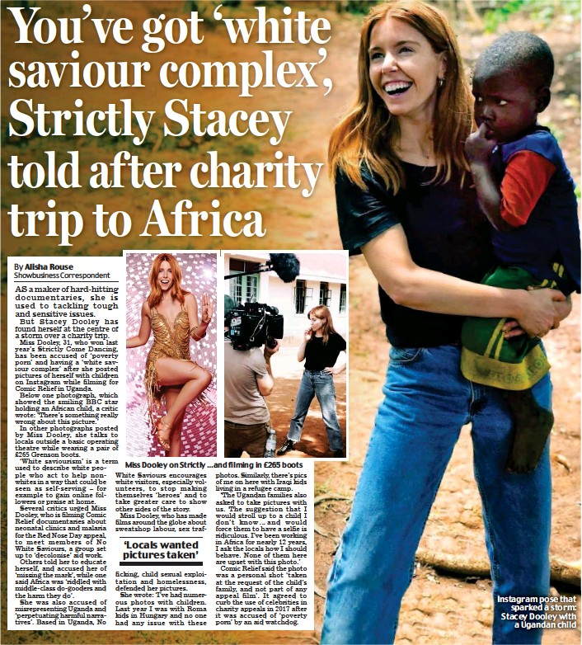
When good intentions, hurt others!
Notes:
If we do not include difference and diversity within our organisations, what would happen. We will end up with cases such as that of COMIC RELIEF – the red nose campaign.
I have seen this for myself in the sector and have had peers say to me “Pennylope, I had good intentions” and I would say I understand and I know but sometimes your good intentions are harmful and can hurt other people.
And the Comic Relief, red nose campaign was an indication of this. Where good intentions can end up hurting other people. The narrative of sending white celebrities to African countries to save or help Africans imposed a white saviour mentality. Implying that Africans who are black can only be helped by white people, and also used as props for campaigns that benefits their organisations instead of the beneficiary groups at hand. This is where they received the backlash and their fundraising campaign was referred to as poverty porn and white saviour complex. Comic relief fundraising campaign failed because it:
Lacked understanding
Failed to mitigate that risk because it didn’t have the right diverse team
Lack cultural sensitivity
Poor decision-making
I highlight this to say, that Comic Relief may have had good intentions but their lack of foresight, their lack of diversity in their teams and lack of diversity in lived experience. Led them to a point of failure in their fundraising campaign.
And this is why it is important to invite and encourage difference/diversity in our workplaces and our sector. It is pivotal!

Slide 8
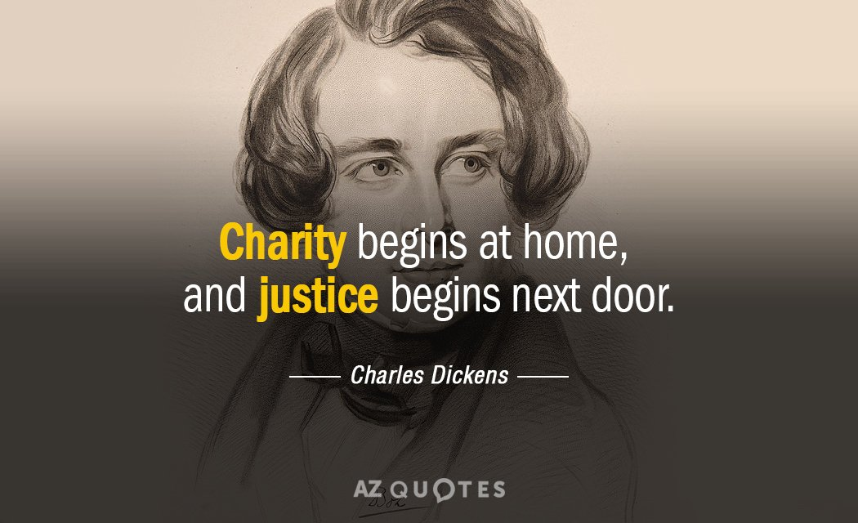
The collective responsibility

Slide 9
What are you going to do differently to embrace difference in your organization?

